Slide 1
Node programming model
Asynchronous Programming

Slide 2
Synchronous vs Asynchronous

Slide 3
Asynchronous model
In Node.JS , Asynchronous is achieved using callback pattern.
Callback is a function that is passed as an argument to another function
Invoked later with the result when the operation completes
It is called CPS – continuation passing style.
Result not directly return to the caller.
Notes:
Callback function will be executed
once I/O is completed
callback is placed in event queue
when eventloop is free and callback is popped from event queue and executed.

Slide 4
What you code in Callback function ?
Instructions you want to happen will be wrapped in callback function
Callback don’t return any value like normal function.
Example:
Q : You read data from http request or file read. What you want to with that data?
A: You want to the send the response to client .
Write this logic in callback function.

Slide 5
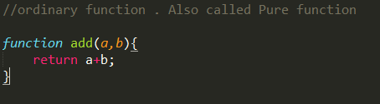
Ordinary function
Simple function
Result is returned to the caller.

Slide 6
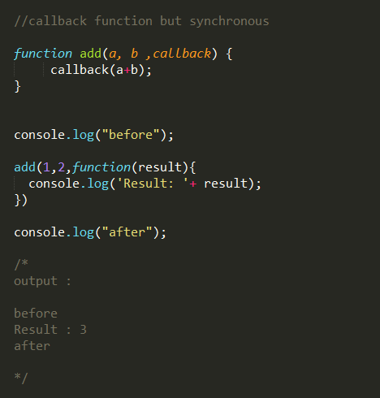
Callback function - Synchronous
CPS function – continuation passing style .
Takes callback as argument/parameter.

Slide 7
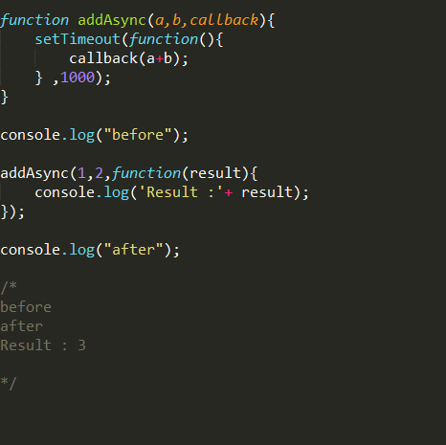
Callback function - Asynchronous
Async function immediately returns to the caller.
Rest of the code gets executed ( by event loop).
Callback function executed later
( by event loop , waiting in event queue)

Slide 8
Point to Ponder
Sync function always blocks (till gets completed)
Async function returns immediately.
In general , function may be sync or async . It should be defined in API.
If function is making I/O call . It must be asynchronous ( node’s philosophy)

Slide 9
How does the callback code runs correctly although when it is executed at the later time ?

Slide 10
Closure!!
Closures are ideal for constructing callback function
Notes:
Exeuction Context is remembered .

Slide 11
NODE.JS STANDARDS

Slide 12
Callback comes last
fs.readFile(filename , [options], callback);
Callback is the last argument.
Easy to read
In API ,easy to validate and check

Slide 13
Error comes first
Error as first argument.
Data/result as the second argument.
fs.readFile(‘foo.txt’, ‘utf8’, function(err, data){
if(err)
handleError(err);
else
processData(data);
});

Slide 14
Why error is part of callback function ?

Slide 15
Why error is part of callback function ?
Async functions returns immediately .
How do we know if any error occurred in the async function?
So , both success(data) and failure(error) cases are handled through callback.
So it becomes responsibility of callback to handle situation.

Slide 16
Error Handling in Node.JS
In Synchronous code , we use throw statement.
In Asynchronous code, error is handled in callback function.

Slide 17
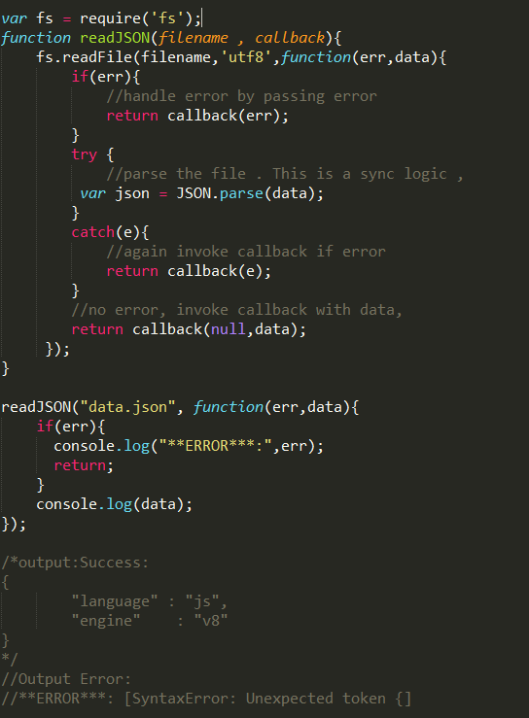
Reading File - v1

Slide 18
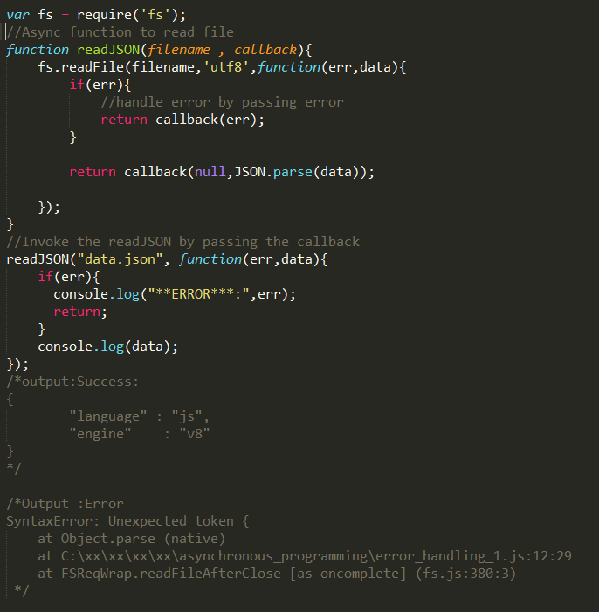
Reading File – v2

Slide 19
Error Handling
Don’t try to use try /catch around async call.
try {
readJSON(“data.json”, function(err, data) { … });
}
catch(err){
//will never reach if readJSON “throws” error
}
Remember, try/catch code runs in different cycle of event loop ,that of readJSON ‘s callback.

